Slide 1
SAMPL8 Challenge MSKCC: Chodera, Isik UCI: Mobley, Bergazin GSK: Bahr, Graves, Kenna, McQueen, Nandkeolyar, Nevins

Slide 2
Aqueous Solubility
pH Solubility Curves

Slide 3
List of Completed pH Solubility Compounds
This is the completed list of compounds processed through Britton-Robinson pH solubility to determine pKa
SAMPL Set 1 SAMPL8-1 SAMPL8-2 SAMPL8-3 SAMPL8-4 SAMPL8-5 SAMPL8-6 | SAMPL Set 2 SAMPL8-7 SAMPL8-8 SAMPL8-9 SAMPL8-10 SAMPL8-11 SAMPL8-12 | SAMPL Set 3 SAMPL8-13 SAMPL8-14 SAMPL8-15 SAMPL8-16 SAMPL8-17 | SAMPL Set 4 SAMPL8-18 SAMPL8-19 SAMPL8-20 SAMPL8-21 SAMPL8-22 SAMPL8-23

Slide 4
List of Completed pH Solubility Compounds
This is the completed list of compounds processed through Britton-Robinson pH solubility to determine pKa
SAMPL Set 1 SAMPL8-1 SAMPL8-2 SAMPL8-3 SAMPL8-4 SAMPL8-5 SAMPL8-6

Slide 5
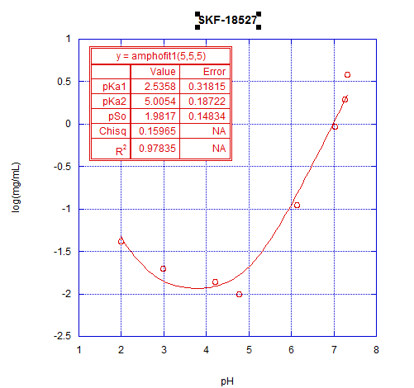
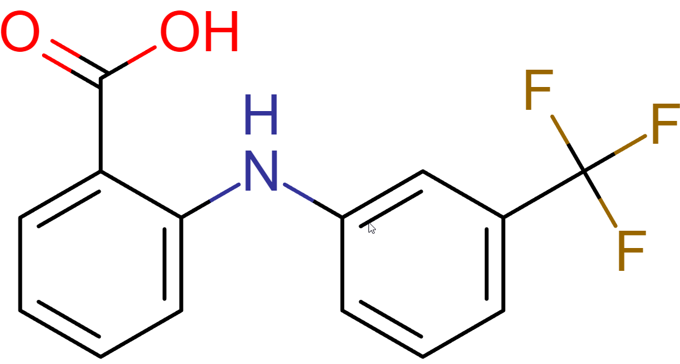
SAMPL8-1
pKa Number | Predicted pKa | Experimental pKa
1 | 3.88 | 2.54, 5.01*
SAMPL8-1
Final pH | Conc. (mg/mL) | Log C
2.0 | 0.042 | -1.38
3.0 | 0.020 | -1.70
4.2 | 0.014 | -1.85
4.8 | 0.010 | -2.00
6.1 | 0.111 | -0.95
7.0 | 0.933 | -0.03
7.3 | 1.970 | 0.29
7.3 | 3.848 | 0.59

Slide 6
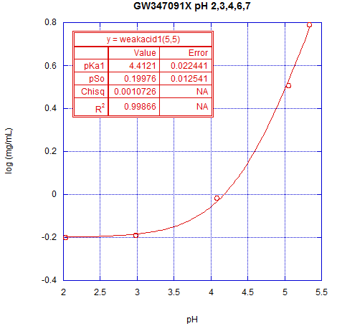
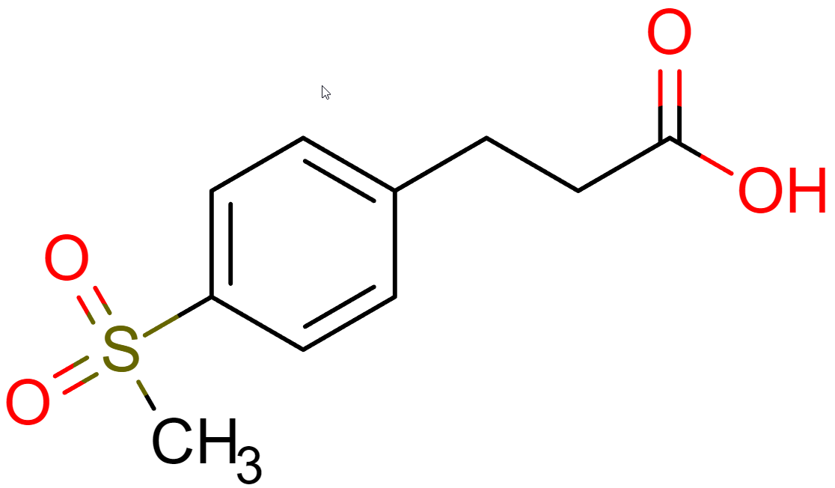
SAMPL8-2
pKa Number | Predicted pKa | Experimental pKa
1 | 3.49 | 4.41
SAMPL8-2
Final pH | Conc. (mg/mL) | Log C
2.0 | 0.630 | -0.20
3.0 | 0.645 | -0.19
4.1 | 0.962 | -0.02
5.1 | 3.202 | 0.51
5.3 | 6.187 | 0.79

Slide 7
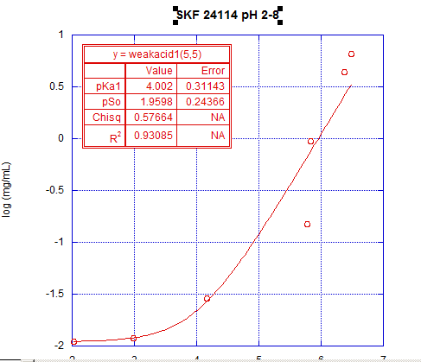
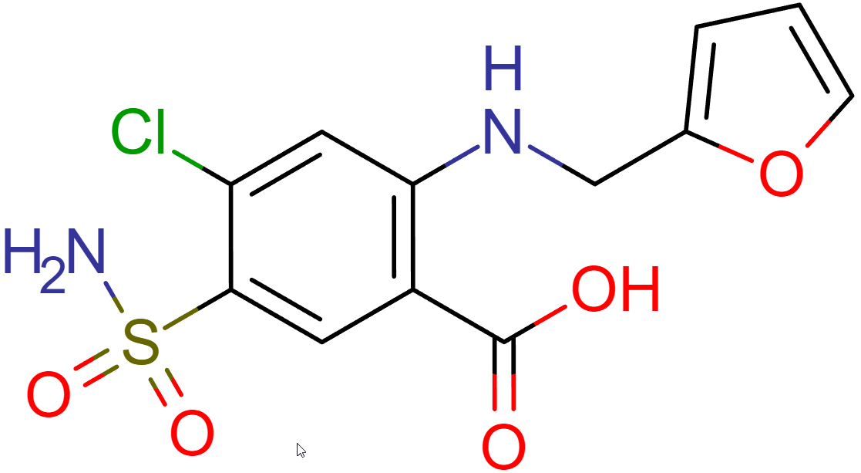
SAMPL8-3
pKa Number | Predicted pKa | Experimental pKa
1 | 4.25 | 4.00
2 | 9.83 | N/A*
SAMPL8-3
Final pH | Conc. (mg/mL) | Log C
2.0 | 0.011 | -1.96
3.0 | 0.012 | -1.92
4.2 | 0.029 | -1.54
5.8 | 0.149 | -0.83
5.8 | 0.950 | -0.02
6.4 | 4.360 | 0.64
6.5 | 6.529 | 0.81

Slide 8
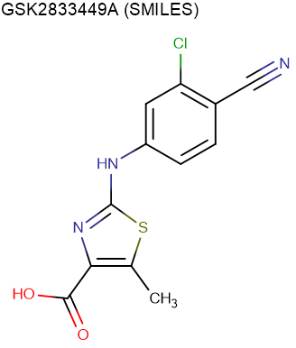
SAMPL8-4
pKa Number | Predicted pKa | Experimental pKa
1 | 4.11 | 5.77
2 | 12.25 | N/A*
SAMPL8-4
Final pH | Conc. (mg/mL) | Log C
1.9 | 0.002 | -2.70
2.4 | 0.003 | -2.52
2.9 | 0.004 | -2.40
4.6 | 0.004 | -2.40
5.0 | 0.003 | -2.52
6.3 | 0.031 | -1.51
6.7 | 0.070 | -1.15
7.7 | 0.186 | -0.73
8.1 | 0.501 | -0.30
8.4 | 0.671 | -0.17

Slide 9
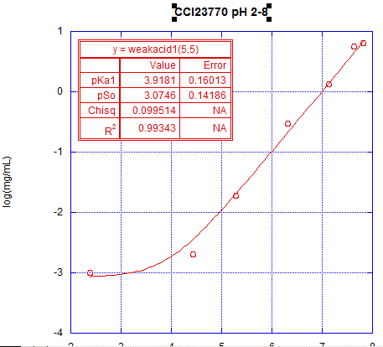
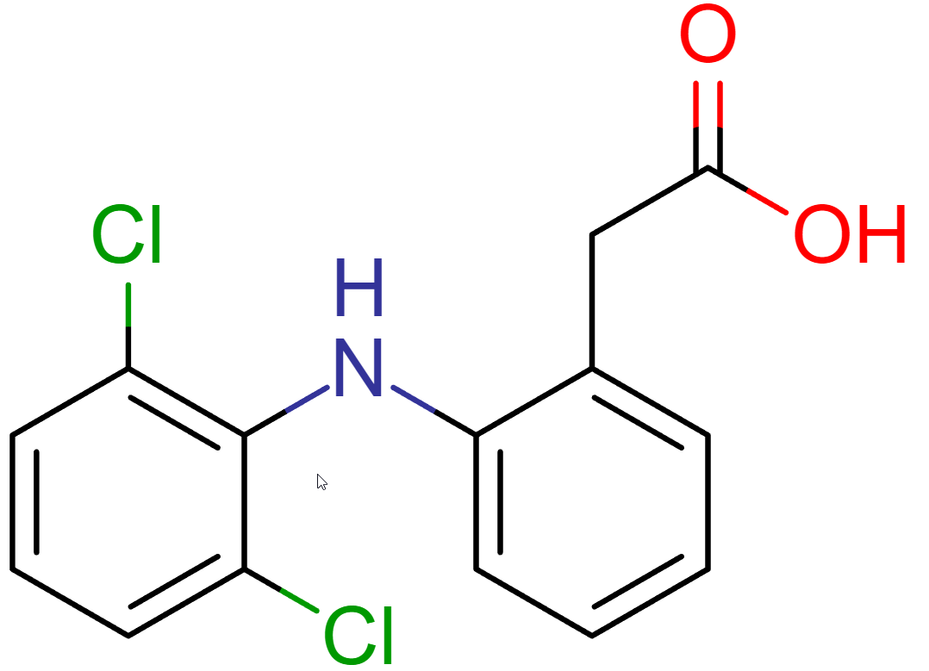
SAMPL8-5
pKa Number | Predicted pKa | Experimental pKa
1 | 4.00 | 3.92
SAMPL8-5
Final pH | Conc. (mg/mL) | Log C
2.4 | 0.001 | -3.00
4.4 | 0.002 | -2.70
5.3 | 0.019 | -1.72
6.3 | 0.297 | -0.53
7.1 | 1.346 | 0.13
7.6 | 5.591 | 0.75
7.8 | 6.456 | 0.81

Slide 10
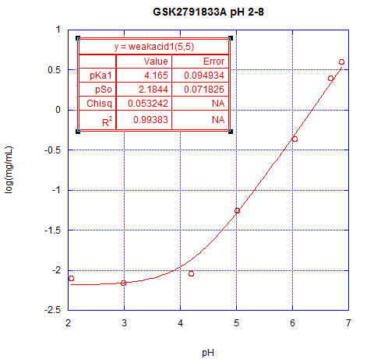
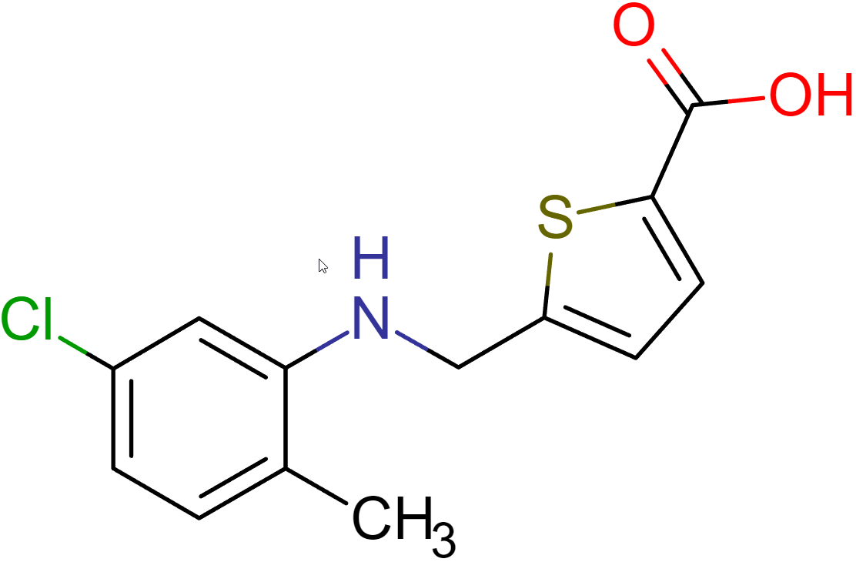
SAMPL8-6
pKa Number | Predicted pKa | Experimental pKa
1 | 4.12 | 4.17
2 | 2.96 | N/A
SAMPL8-6
Final pH | Conc. (mg/mL) | Log C
2.1 | 0.008 | -2.10
3.0 | 0.007 | -2.15
4.2 | 0.009 | -2.05
5.0 | 0.055 | -1.26
6.0 | 0.433 | -0.36
6.7 | 2.519 | 0.40
6.9 | 4.008 | 0.60

Slide 11
List of Completed pH Solubility Compounds
This is the completed list of compounds processed through Britton-Robinson pH solubility to determine pKa
 | SAMPL Set 2 SAMPL8-7 SAMPL8-8 SAMPL8-9 SAMPL8-10 SAMPL8-11 SAMPL8-12

Slide 12
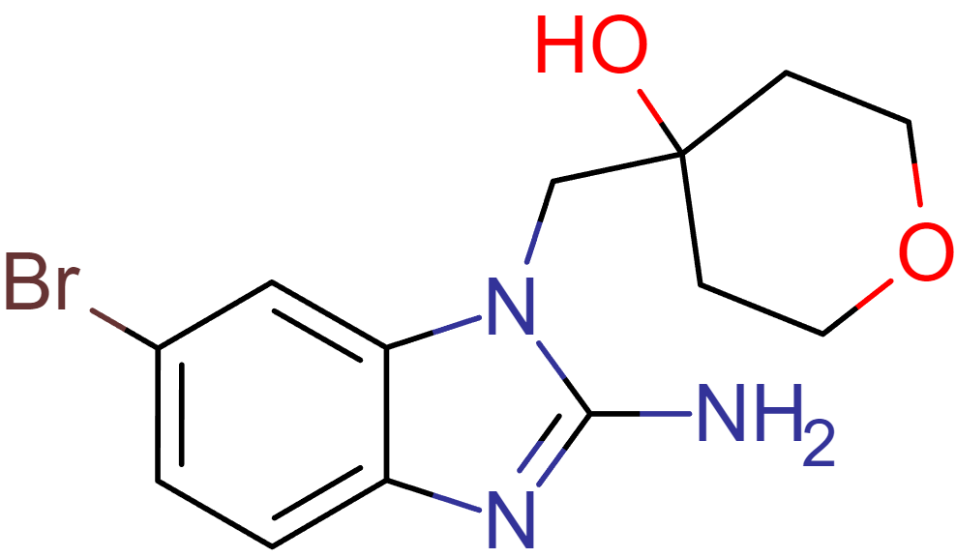
SAMPL8-7
pKa Number | Predicted pKa | Experimental pKa
1 | 7.55 | 6.63
SAMPL8-7
Final pH | Conc. (mg/mL) | Log C
4.5 | 7.166 | 0.86
4.8 | 3.603 | 0.56
5.3 | 1.018 | 0.01
6.2 | 0.159 | -0.80
7.3 | 0.058 | -1.24
8.3 | 0.048 | -1.32
9.1 | 0.045 | -1.35
10.1 | 0.055 | -1.26
10.2 | 0.050 | -1.30
11.0 | 0.052 | -1.28

Slide 13
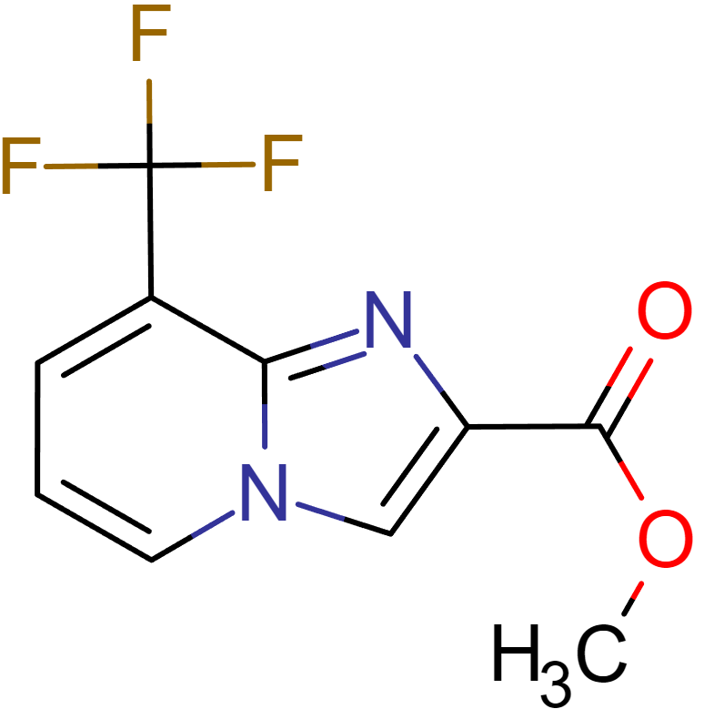
SAMPL8-8
pKa Number | Predicted pKa | Experimental pKa
1 | 2.72 | 2.78
SAMPL8-8
Final pH | Conc. (mg/mL) | Log C
2.1 | 8.070 | 0.91
3.0 | 1.372 | 0.14
4.2 | 1.284 | 0.11
5.1 | 1.265 | 0.10
6.0 | 1.253 | 0.10
7.3 | 1.233 | 0.09
8.2 | 1.223 | 0.09
9.1 | 1.195 | 0.08
10.0 | 1.143 | 0.06

Slide 14
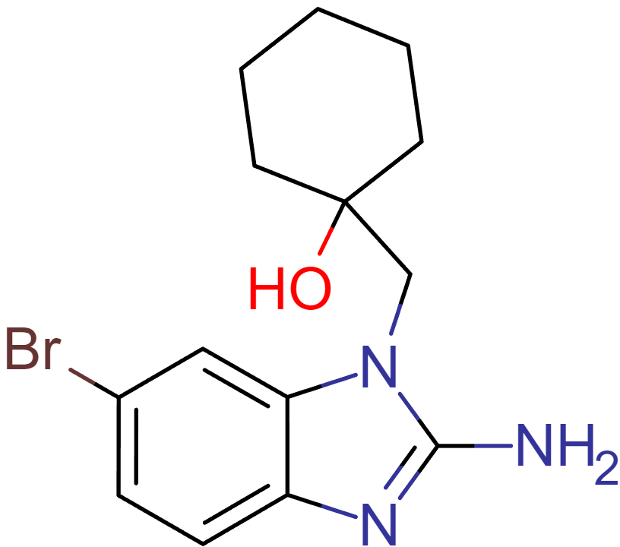
SAMPL8-9
pKa Number | Predicted pKa | Experimental pKa
1 | 7.55 | 6.08
SAMPL8-9
Final pH | Conc. (mg/mL) | Log C
4.5 | 0.608 | -0.22
5.8 | 0.099 | -1.00
7.1 | 0.030 | -1.52
8.0 | 0.024 | -1.62
9.0 | 0.021 | -1.68
10.0 | 0.021 | -1.68
10.3 | 0.021 | -1.68
10.8 | 0.020 | -1.70

Slide 15
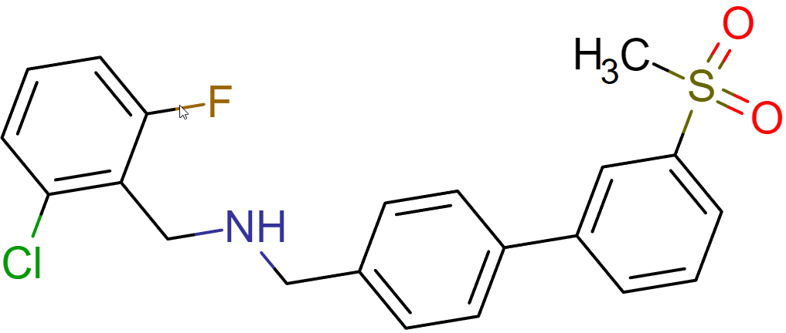
SAMPL8-10
pKa Number | Predicted pKa | Experimental pKa
1 | 6.93 | 7.71
SAMPL8-10
Final pH | Conc. (mg/mL) | Log C
4.2 | 16.911 | 1.23
4.7 | 12.500 | 1.10
5.2 | 2.748 | 0.44
6.5 | 0.064 | -1.19
6.8 | 0.027 | -1.57
7.8 | 0.011 | -1.96
9.5 | 0.008 | -2.10
10.1 | 0.006 | -2.22
10.7 | 0.005 | -2.30

Slide 16
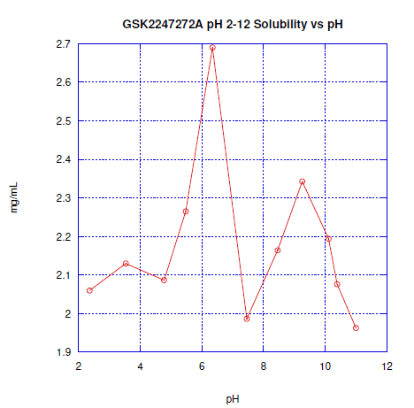
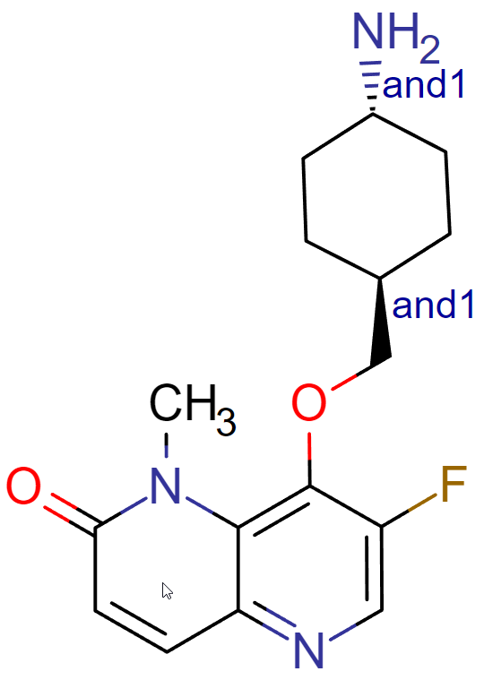
SAMPL8-11
pKa Number | Predicted pKa | Experimental pKa
1 | 10.45 | N/A
2 | 3.06 | N/A
SAMPL8-11
Final pH | Conc. (mg/mL) | Log C
2.4 | 2.060 | 0.31
3.5 | 2.130 | 0.33
4.8 | 2.087 | 0.32
5.5 | 2.265 | 0.36
6.4 | 2.690 | 0.43
7.5 | 1.987 | 0.30
8.5 | 2.164 | 0.34
9.3 | 2.343 | 0.37
10.1 | 2.194 | 0.34
10.4 | 2.076 | 0.32
11.0 | 1.963 | 0.29

Slide 17
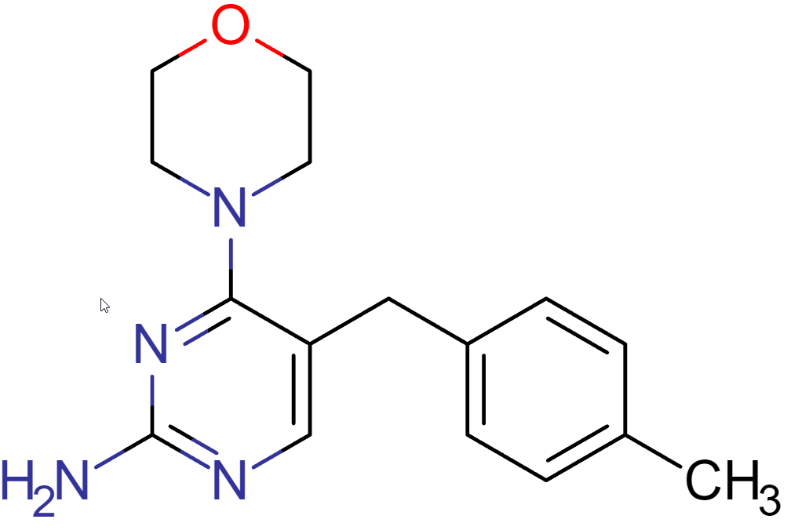
SAMPL8-12
pKa Number | Predicted pKa | Experimental pKa
1 | 6.89 | 6.98
SAMPL8-12
Final pH | Conc. (mg/mL) | Log C
4.3 | 2.502 | 0.40
4.7 | 1.826 | 0.26
5.2 | 0.381 | -0.42
6.1 | 0.041 | -1.39
7.2 | 0.010 | -2.00
8.1 | 0.007 | -2.15
8.9 | 0.006 | -2.22
9.5 | 0.006 | -2.22
10.2 | 0.006 | -2.22
11.2 | 0.006 | -2.22

Slide 18
List of Completed pH Solubility Compounds
This is the completed list of compounds processed through Britton-Robinson pH solubility to determine pKa
 |  | SAMPL Set 3 SAMPL8-13 SAMPL8-14 SAMPL8-15 SAMPL8-16 SAMPL8-17

Slide 19
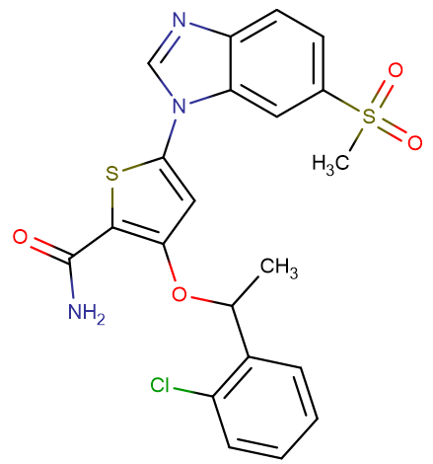
SAMPL8-13
pKa Number | Predicted pKa | Experimental pKa
1 | 13.86 | N/A
2 | 4.13 | N/A
SAMPL8-13
Final pH | Conc. (mg/mL) | Log C
2.0 | 0.005 | -2.30
3.0 | 0.007 | -2.15
4.2 | 0.003 | -2.52
5.1 | 0.003 | -2.52
6.2 | 0.003 | -2.52
7.2 | 0.003 | -2.52
7.8 | 0.003 | -2.52
8.6 | 0.003 | -2.52
9.0 | 0.003 | -2.52
9.1 | 0.003 | -2.52
9.3 | 0.002 | -2.70

Slide 20
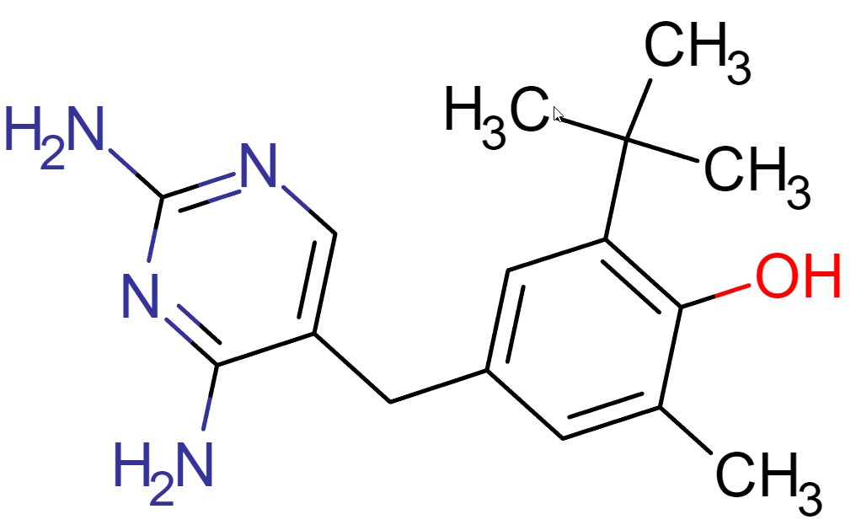
SAMPL8-14
pKa Number | Predicted pKa | Experimental pKa
1 | 11.06 | N/A
2 | 7.16 | 7.27
SAMPL8-14
Final pH | Conc. (mg/mL) | Log C
5.2 | 1.560 | 0.19
5.9 | 0.619 | -0.21
6.9 | 0.077 | -1.11
7.3 | 0.035 | -1.46
8.3 | 0.020 | -1.70
8.8 | 0.018 | -1.74
9.0 | 0.018 | -1.74

Slide 21
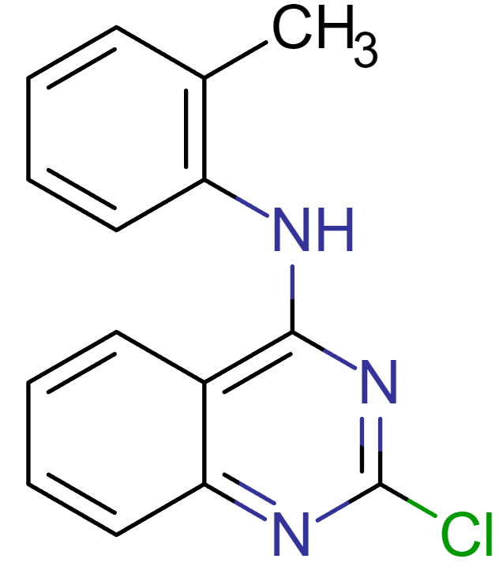
SAMPL8-15
pKa Number | Predicted pKa | Experimental pKa
1 | 1.34 | 2.54
SAMPL8-15
Final pH | Conc. (mg/mL) | Log C
2.0 | 0.047 | -1.33
3.0 | 0.014 | -1.85
4.2 | 0.011 | -1.96
5.1 | 0.011 | -1.96
6.2 | 0.011 | -1.96
7.2 | 0.011 | -1.96
7.8 | 0.010 | -2.00
9.1 | 0.010 | -2.00
9.1 | 0.010 | -2.00

Slide 22
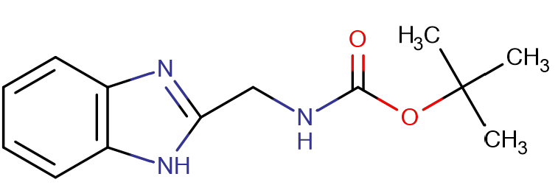
SAMPL8-16
pKa Number | Predicted pKa | Experimental pKa
1 | 11.47 | N/A
2 | 5.05 | 5.10
SAMPL8-16
Final pH | Conc. (mg/mL) | Log C
3.6 | 9.366 | 0.97
4.0 | 2.676 | 0.43
4.4 | 0.777 | -0.11
5.2 | 0.373 | -0.43
6.2 | 0.252 | -0.60
7.2 | 0.197 | -0.71
7.8 | 0.208 | -0.68
8.5 | 0.203 | -0.69

Slide 23
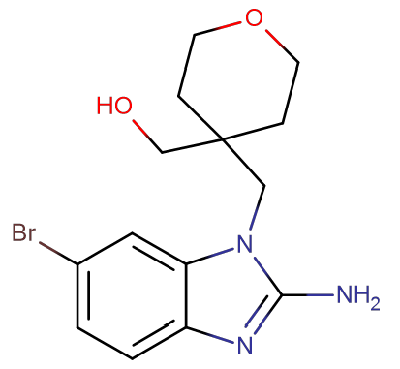
SAMPL8-17
pKa Number | Predicted pKa | Experimental pKa
1 | 7.59 | 6.58
SAMPL8-17
Final pH | Conc. (mg/mL) | Log C
4.8 | 3.127 | 0.50
5.1 | 2.373 | 0.38
5.4 | 1.437 | 0.16
6.2 | 0.273 | -0.56
7.2 | 0.093 | -1.03
7.8 | 0.076 | -1.12
8.9 | 0.070 | -1.15
9.5 | 0.068 | -1.17
9.1 | 0.067 | -1.17
9.3 | 0.070 | -1.15

Slide 24
List of Completed pH Solubility Compounds
This is the completed list of compounds processed through Britton-Robinson pH solubility to determine pKa
 |  |  | SAMPL Set 4 SAMPL8-18 SAMPL8-19 SAMPL8-20 SAMPL8-21 SAMPL8-22 SAMPL8-23

Slide 25
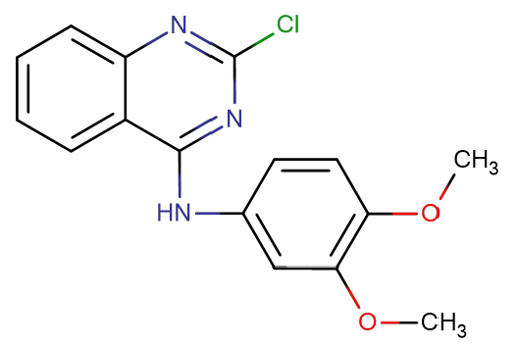
SAMPL8-18
pKa Number | Predicted pKa | Experimental pKa
1 | 1.34 | 2.72
SAMPL8-18
Final pH | Conc. (mg/mL) | Log C
2.0 | 0.013 | -1.89
3.0 | 0.004 | -2.40
4.2 | 0.002 | -2.70
5.2 | 0.003 | -2.52
6.2 | 0.002 | -2.70
7.2 | 0.002 | -2.70
7.8 | 0.002 | -2.70
8.8 | 0.002 | -2.70
9.6 | 0.002 | -2.70
10.3 | 0.002 | -2.70
11.4 | 0.003 | -2.52

Slide 26
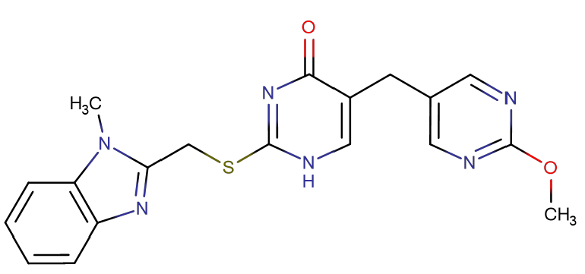
SAMPL8-19
pKa Number | Predicted pKa | Experimental pKa
1 | 4.77 | 4.93
2 | 9.54 | 6.99
SAMPL8-19
Final pH | Conc. (mg/mL) | Log C
2.3 | 5.299 | 0.72
3.1 | 0.684 | -0.17
4.1 | 0.086 | -1.06
5.2 | 0.026 | -1.59
6.2 | 0.012 | -1.91
7.2 | 0.023 | -1.65
7.8 | 0.069 | -1.16
8.9 | 0.628 | -0.20
9.3 | 2.401 | 0.38
9.3 | 6.431 | 0.81
10.0 | 9.058 | 0.96

Slide 27
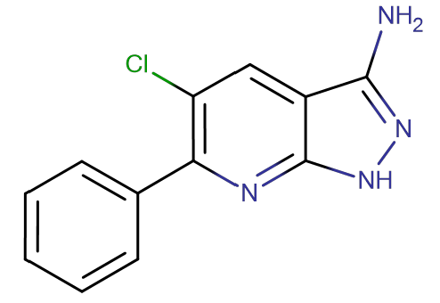
SAMPL8-20
pKa Number | Predicted pKa | Experimental pKa
1 | 3.54 | 2.44
2 | N/A | 11.44
SAMPL8-20
Final pH | Conc. (mg/mL) | Log C
2.0 | 0.087 | -1.06
3.1 | 0.035 | -1.46
6.3 | 0.021 | -1.68
7.2 | 0.022 | -1.66
7.8 | 0.022 | -1.65
8.9 | 0.024 | -1.62
9.5 | 0.025 | -1.60
10.0 | 0.033 | -1.48
11.4 | 0.043 | -1.37

Slide 28
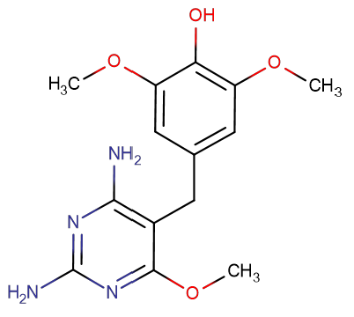
SAMPL8-21
pKa Number | Predicted pKa | Experimental pKa
1 | 6.85 | 5.38
2 | 9.44 | N/A
SAMPL8-21
Final pH | Conc. (mg/mL) | Log C
2.4 | 9.578 | 0.98
3.8 | 3.948 | 0.60
4.3 | 1.338 | 0.13
5.0 | 0.267 | -0.57
6.2 | 0.110 | -0.96
7.2 | 0.071 | -1.15
7.9 | 0.092 | -1.04
8.6 | 0.066 | -1.18
9.5 | 0.023 | -1.64
9.9 | 0.021 | -1.68
10.8 | 0.054 | -1.27

Slide 29
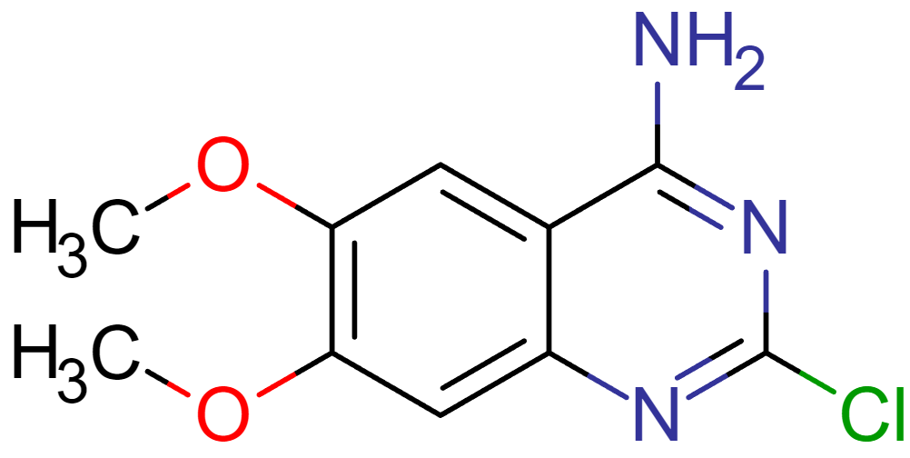
SAMPL8-22
pKa Number | Predicted pKa | Experimental pKa
1 | 2.94 | 3.36
SAMPL8-22
Final pH | Conc. (mg/mL) | Log C
2.1 | 0.023 | -1.63
3.3 | 0.022 | -1.67
4.2 | 0.014 | -1.86
5.4 | 0.012 | -1.92
6.2 | 0.010 | -2.01
7.1 | 0.011 | -1.96
7.9 | 0.010 | -1.99
8.9 | 0.010 | -2.00
9.6 | 0.009 | -2.04
10.0 | 0.009 | -2.03
11.3 | 0.009 | -2.05

Slide 30
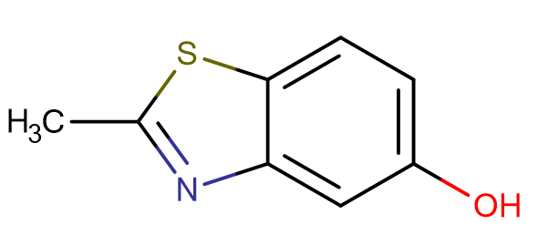
SAMPL8-23
pKa Number | Predicted pKa | Experimental pKa
1 | 3.46 | 2.65
2 | 9.15 | 9.02
SAMPL8-23
Final pH | Conc. (mg/mL) | Log C
2.1 | 1.729 | 0.24
3.1 | 0.527 | -0.28
4.2 | 0.383 | -0.42
5.3 | 0.383 | -0.42
6.2 | 0.388 | -0.41
7.2 | 0.407 | -0.39
7.8 | 0.423 | -0.37
8.7 | 0.490 | -0.31
9.3 | 1.028 | 0.01
9.6 | 1.704 | 0.23
10.0 | 4.671 | 0.67

